Slide 1
Statistical Analysis
Two group comparisons

Slide 2
Story
Tennis ball bounce.
Developed a new method to improve the tennis bounce – changing pressure inside ball
A sample of 100 balls under usual process
A sample of 100 balls under this new process
Want to see if there is a difference between the average bounce heights for the processes.

Slide 3
Model
Population 1
Outcome variable
Height of bounce
Population 2
Sample 2
Sample 1
Is there a difference between the two population means?
Answer this by looking at sample results

Slide 4
Some other comments
Two different samples
Independent samples within each group
Quantitative outcome variable
Do not have to have same numbers in each sample group

Slide 5
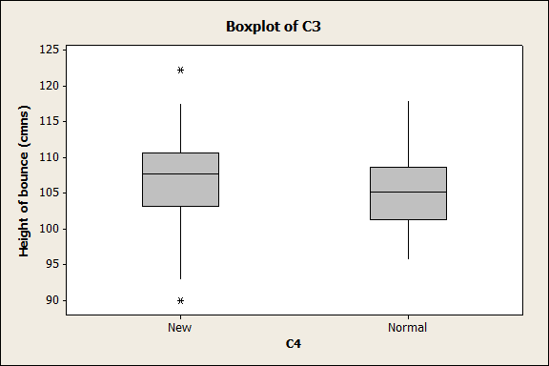
Graph
Process | Mean | SD | N
New | 106.9 | 5.76 | 100
Usual | 104.89 | 4.78 | 100

Slide 6
Some theory – never never land
Suppose we took a sample from each population
Calculated the means and the difference in the means
What happens if we do this again and again and look at the difference in the means?
Sampling distribution of the difference in the means.

Slide 7
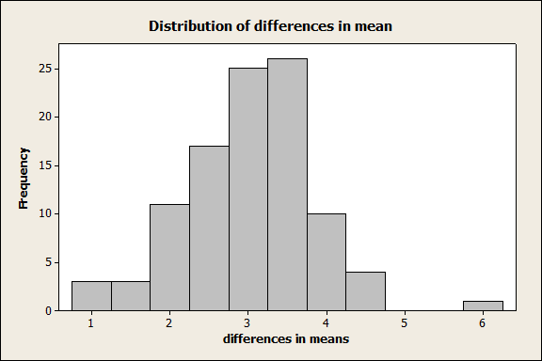
Results of 10 samples
3.58
2.88
4.19
3.95
2.60
3.03
4.39
2.84
1.99
2.77
Mean = difference in population means
SD= SE(difference in the means)

Slide 8
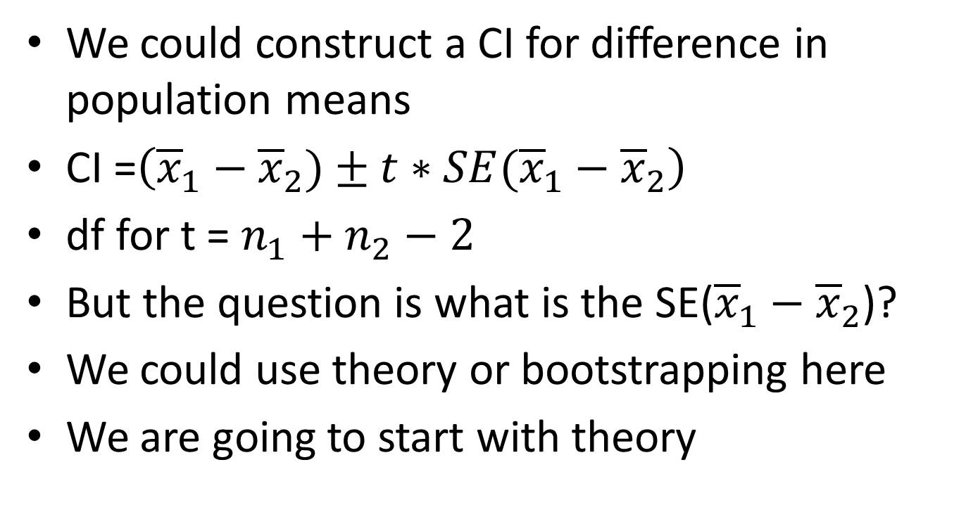
Confidence interval
We could construct a CI for difference in population means
CI =$\left({\overline{x}}_{1}−{\overline{x}}_{2})±t∗SE({\overline{x}}_{1}−{\overline{x}}_{2}\right)$
df for t = $n_{1}+n_{2}−2$
But the question is what is the SE(${\overline{x}}_{1}−{\overline{x}}_{2}$)?
We could use theory or bootstrapping here
We are going to start with theory

Slide 9
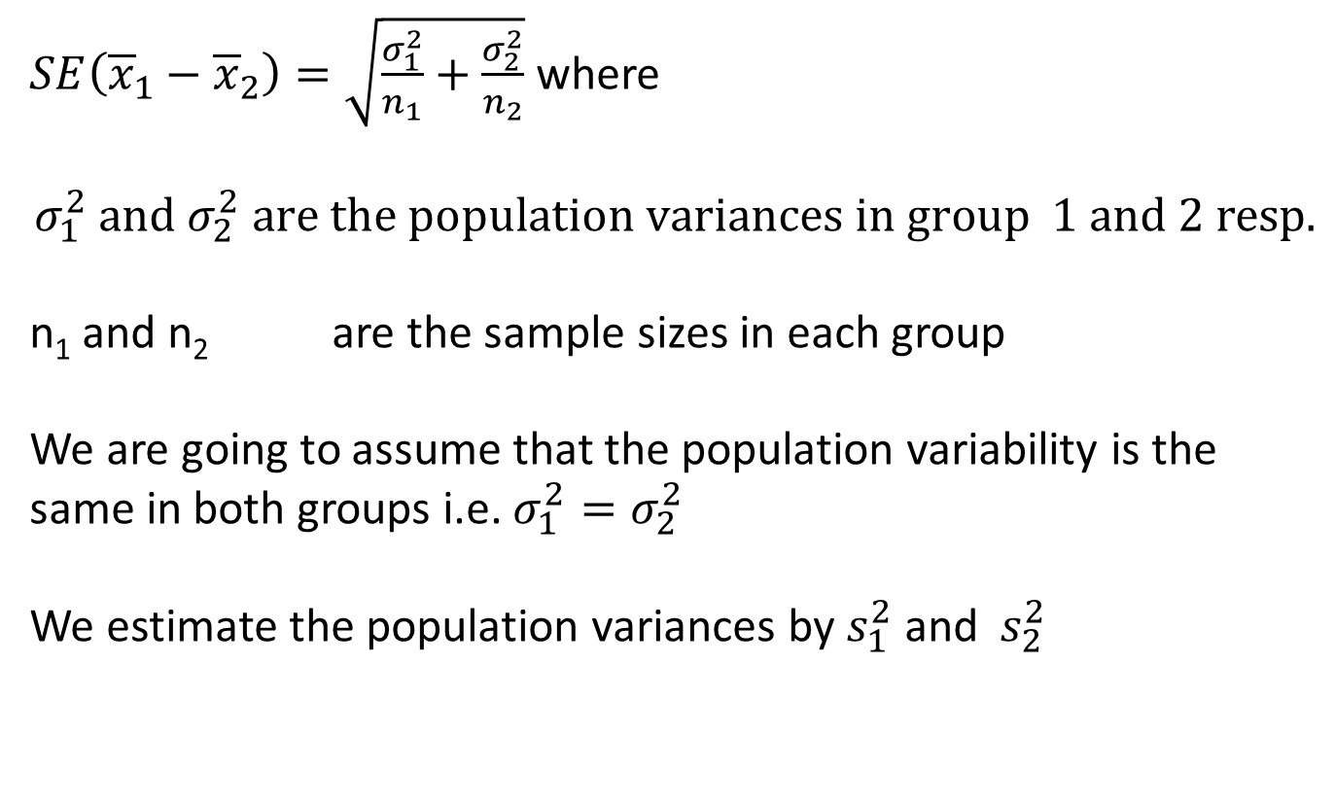
SE (difference in means)
$SE\left({\overline{x}}_{1}−{\overline{x}}_{2}\right)=\sqrt{\frac{σ_{1}^{2}}{n_{1}}+\frac{σ_{2}^{2}}{n_{2}}}$ where
$$σ_{1}^{2} and{ σ}_{2}^{2} are the population variances in group 1 and 2 resp.$$
n₁ and n₂ are the sample sizes in each group
We are going to assume that the population variability is the same in both groups i.e. $σ_{1}^{2}=σ_{2}^{2}$
We estimate the population variances by${ s}_{1}^{2}$ and ${ s}_{2}^{2}$

Slide 10
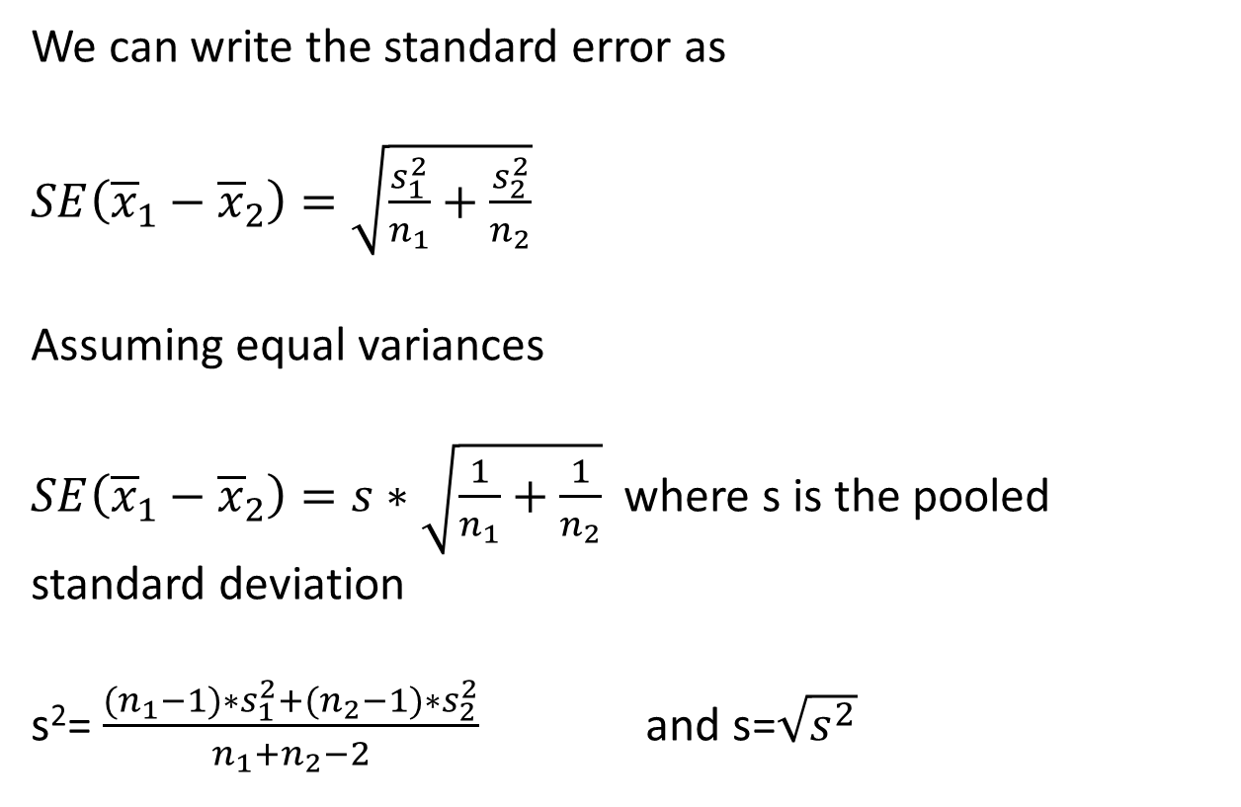
And more ..
We can write the standard error as
$SE\left({\overline{x}}_{1}−{\overline{x}}_{2}\right)=\sqrt{\frac{s_{1}^{2}}{n_{1}}+\frac{s_{2}^{2}}{n_{2}}}$
Assuming equal variances
$SE\left({\overline{x}}_{1}−{\overline{x}}_{2}\right)=s∗\sqrt{\frac{1}{n_{1}}+\frac{1}{n_{2}}}$ where s is the pooled standard deviation
s²= $\frac{{(n}_{1}−1)∗s_{1}^{2}+{(n}_{2}−1)∗s_{2}^{2}}{n_{1}+n_{2}−2}$ and s=$\sqrt{s^{2}}$

Slide 11
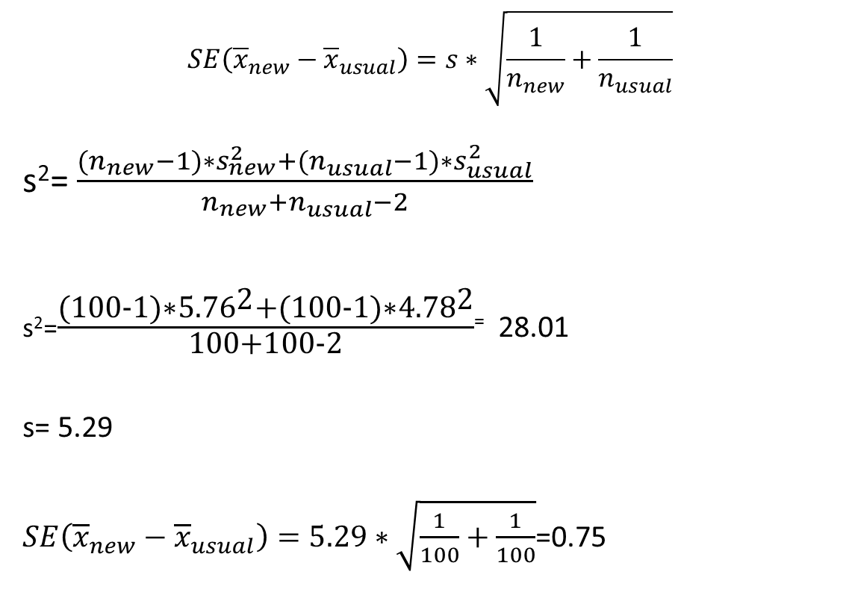
And more again..
$$SE\left({\overline{x}}_{new}−{\overline{x}}_{usual}\right)=s∗\sqrt{\frac{1}{n_{new}}+\frac{1}{n_{usual}}}$$
s²= $\frac{{(n}_{new}−1)∗s_{new}^{2}+{(n}_{usual}−1)∗s_{usual}^{2}}{n_{new}+n_{usual}−2}$
s²=$\frac{\text{(100-1)∗}{\text{5.76}}^{\text{2}}\text{+(100-1)∗}{\text{4.78}}^{\text{2}}}{\text{100+100-2}}$⁼ 28.01
s= 5.29
$SE\left({\overline{x}}_{new}−{\overline{x}}_{usual}\right)=5.29∗\sqrt{\frac{1}{100}+\frac{1}{100}}$=0.75

Slide 12
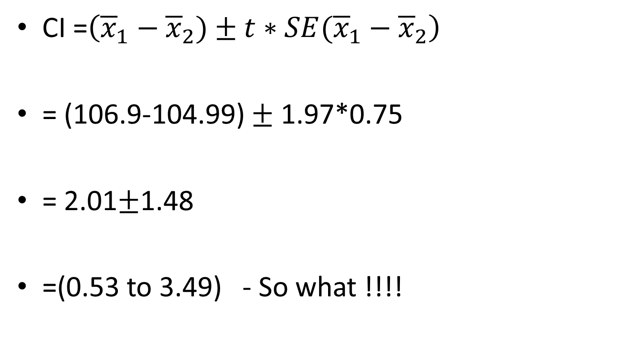
95% CI
CI =$\left({\overline{x}}_{1}−{\overline{x}}_{2})±t∗SE({\overline{x}}_{1}−{\overline{x}}_{2}\right)$
= (106.9-104.99) $±$ 1.97*0.75
= 2.01$±$1.48
=(0.53 to 3.49) - So what !!!!

Slide 13
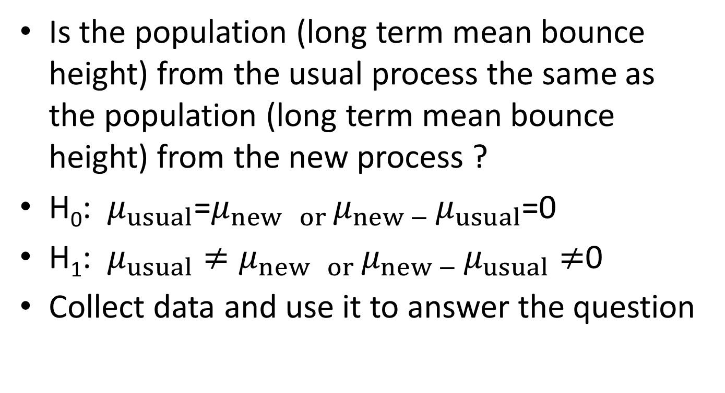
State hypotheses
Is the population (long term mean bounce height) from the usual process the same as the population (long term mean bounce height) from the new process ?
H₀: $μ_{usual}$=$μ_{new or }μ_{new − }μ_{usual}$=0
H₁: $μ_{usual}≠μ_{new or }μ_{new − }μ_{usual}≠$0
Collect data and use it to answer the question

Slide 14
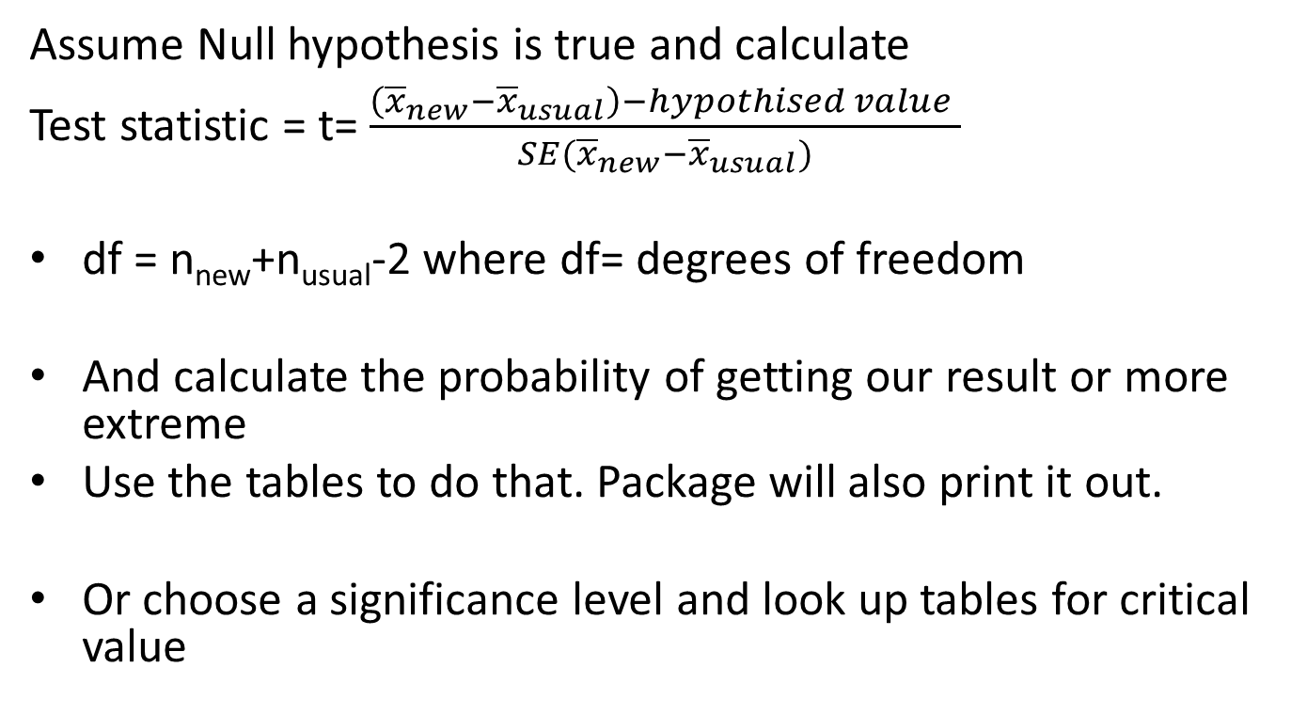
And more
Assume Null hypothesis is true and calculate
Test statistic = t= $\frac{\left({\overline{x}}_{new}−{\overline{x}}_{usual}\right)−hypothised value }{SE({\overline{x}}_{new}−{\overline{x}}_{usual})}$
df = n_{new}+n_{usual}-2 where df= degrees of freedom
And calculate the probability of getting our result or more extreme
Use the tables to do that. Package will also print it out.
Or choose a significance level and look up tables for critical value

Slide 15
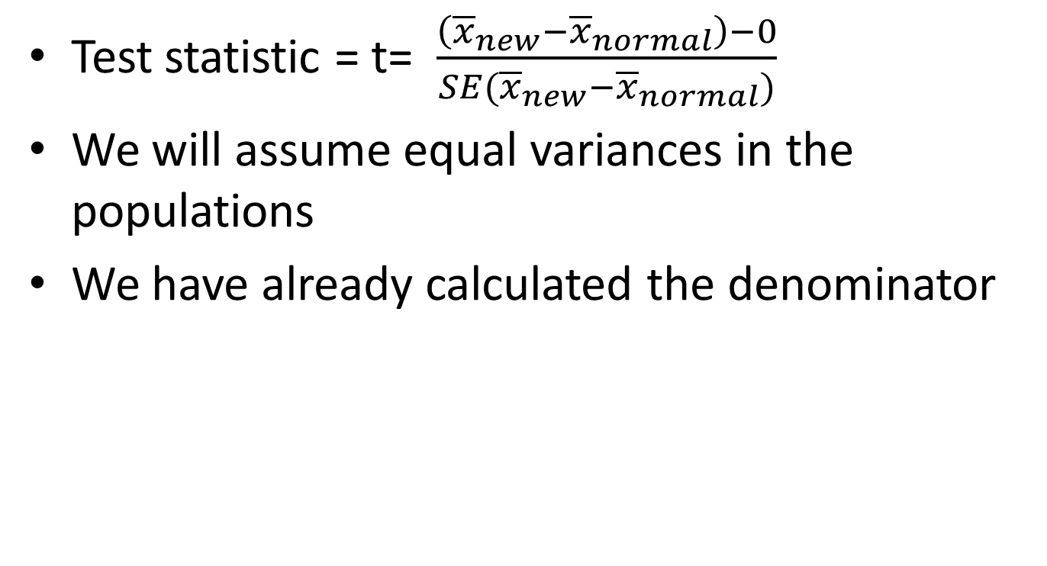
And ….
Test statistic = t= $\frac{\left({\overline{x}}_{new}−{\overline{x}}_{normal}\right)−0}{SE({\overline{x}}_{new}−{\overline{x}}_{normal})}$
We will assume equal variances in the populations
We have already calculated the denominator

Slide 16
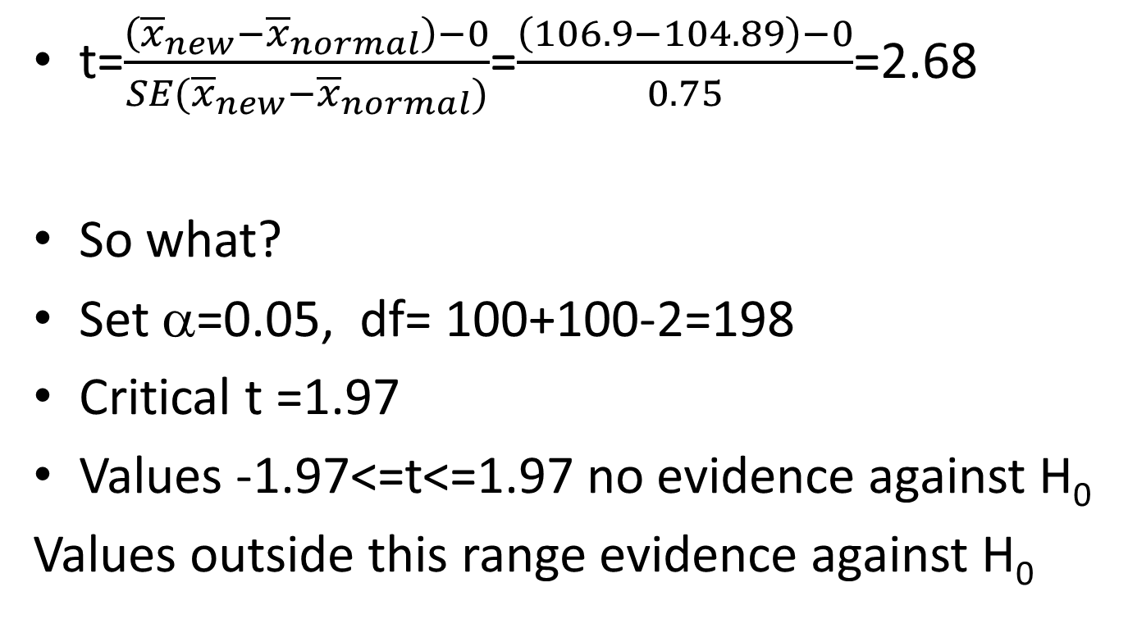
Test
t=$\frac{\left({\overline{x}}_{new}−{\overline{x}}_{normal}\right)−0}{SE({\overline{x}}_{new}−{\overline{x}}_{normal})}$=$\frac{\left(106.9−104.89\right)−0}{0.75}$=2.68
So what?
Set α=0.05, df= 100+100-2=198
Critical t =1.97
Values -1.97<=t<=1.97 no evidence against H₀
Values outside this range evidence against H₀

Slide 17
So …
As 2.68 is outside the interval we have sufficient evidence against the H0
And conclude that the two long term averages are different.
Our confidence interval tells how big a difference
Let us look at Minitab output

Slide 18
Minitab output
Two-sample T for C3
Difference = mu (New) - mu (Normal)
Estimate for difference: 2.016
95% CI for difference: (0.540, 3.492)
T-Test of difference = 0 (vs not =): T-Value = 2.69 P-Value = 0.008 DF = 198
Both use Pooled StDev = 5.2926
C4 | N | Mean | StDev | SE Mean
New | 100 | 106.9 | 5.76 | 0.58
Normal | 100 | 104.89 | 4.78 | 0.48

Slide 19
Comments
p=0.008 which is p< .05
Evidence against H₀
We have evidence of a difference between the two long term averages processes
95% CI= (0.540, 3.492)
Long term mean for the bounce hgt. for the new process is between 0.54 and 3.492 cms greater than the old process.

Slide 20
Comments
0 is not included in this interval.
Got to ask – is this an important difference
Need background knowledge to answer that question.
What does it mean if 95% CI includes 0?

Slide 21
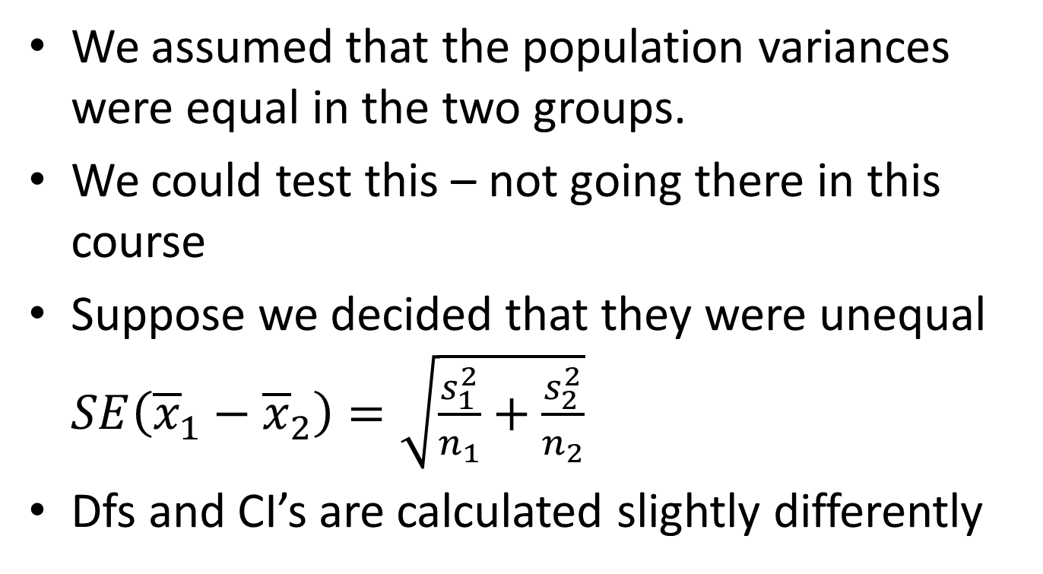
Unequal variances
We assumed that the population variances were equal in the two groups.
We could test this – not going there in this course
Suppose we decided that they were unequal $SE\left({\overline{x}}_{1}−{\overline{x}}_{2}\right)=\sqrt{\frac{s_{1}^{2}}{n_{1}}+\frac{s_{2}^{2}}{n_{2}}}$
Dfs and CI’s are calculated slightly differently

Slide 22
Minitab output
Two-Sample T-Test and CI: C3, C4
Two-sample T for C3
C4 N Mean StDev SE Mean
New 100 106.90 5.76 0.58
Normal 100 104.89 4.78 0.48
Difference = mu (New) - mu (Normal)
Estimate for difference: 2.016
95% CI for difference: (0.539, 3.492)
T-Test of difference = 0 (vs not =): T-Value = 2.69 P-Value = 0.008 DF = 191

Slide 23
Another situation
Population
Simple random sample
Group A
Randomly assign to each group
Group B

Slide 24
Other bits and pieces
More than 2 groups – use another technique
Very skewed outcome variable – what do we do?
Transform data – take logs
Use other techniques
Not going to worry about these matters in this course

Slide 25
Summary
What is the story behind the data?
Simple random sampling within groups
Two independent groups
Quantitative outcome variable- not too skewed
Question in English
Graph + descriptive statistics
Hypotheses
Test statistic
If significant provide a CI
If not, what is the question?

